Slide 1
Research Work Presentation
Topic - Fake/Real News Classification Using CNN
By - Vaibhav Kumar Sunkaria
National Chengchi University
Advisor - Professor Yuh-Jong Hu

Slide 2
What is Fake News?
Fake news is designed to deliberately spread hoaxes,propaganda and disinformation
Fake news stories usually spread through social media platforms
Often fake news will mimic real headlines and twist the story.

Slide 3

Why is detecting fake news so important

Slide 4
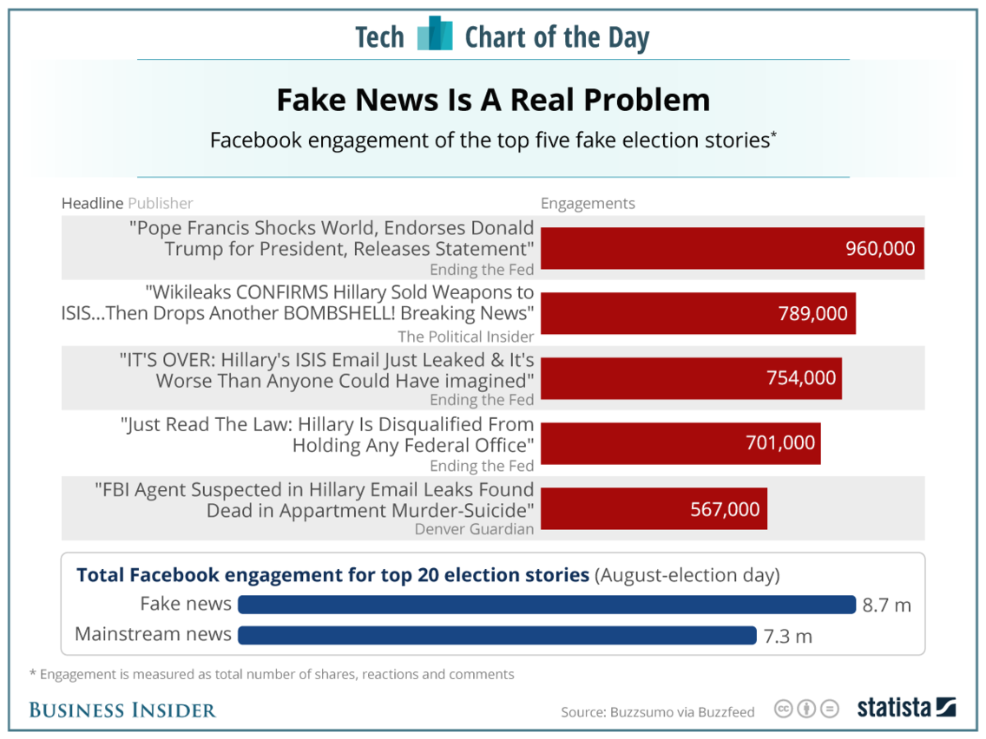

Slide 5
Distinct Approaches in Machine Learning to detect fake news
Linguistic Approaches - The methods based on word analysis is not enough to identify deception. In this case, the sentences are represented as a parse tree to describe syntax structure.
2. Network Based Approaches
3. Neural Network based Approaches - Convolutional neural networks (CNN) utilize filters to capture the local structures of the image, which performs very well on computer vision tasks. Researchers also find that CNN is effective on many NLP tasks. For instance, semantic parsing , sentence modeling , and other traditional NLP tasks.

Slide 6
Dataset / Corpus Exploration
Authenticated fact checked data sources.
Challenging problem to collect dataset
Data set published for research purposes e.g. kaggle dataset
Dataset cleaning and preparation for learning algorithm
NLP Techniques, stop words removal,padding documents to be of same length, drop missing columns

Slide 7
Why Need For Deep Learning Approaches like CNN and Deep CNN
Traditional models doesn’t capture semantics in text.
The words with similar meaning appear together in similar concept and must have similar representation
2. Word embeddings and n-gram models come to rescue
N-gram models ,skip gram models(Probabilistic language model)
3. Vectorization - Glove Vectors(Used in my model), Word2Vec, FastText

Slide 8
CNN in Text Classification
CNN
State of the art in computer vision models, sentence classification,convoluted layers , pooling layers and fully connected layers
2. How does CNN fit for Text and NLP
CNN maintain spatial structure of text which in one dimensional in case of text
Feature Extraction for text effective using convoluted layers
Global Feature Extraction from feature vectors using Global Max Pooling 1D

Slide 9
Experimental Setup
We use 80% of the data for training, 10% of the data for validation and 10% of the data for testing
All the experiments are run atleast 10 times separately
Glove embedding dimension is set to 100 and filter size is set 3*3

Slide 10
Experimental Setup (Contd.)
4. Word Embedding - We use 3 Layer neural network for the word embedding it can of size 50 to 350 but after 100 precision and recall decreases therefore i choose 100 dimension embedding.
5.Hidden Layer dimension - Its most important factor to determine final output too less or too large size can cause underfitting or overfitting of data.
Thus i choose 128 for the hidden layer dimension

Slide 11
CNN Model for Text Classifation
Input =>
Embedding Layer
Convolutional Layer 1
And Max Pooling
Convolutional Layer 2
And Max Pooling
Convolutional Layer 3 and Max Pooling
Output Layer
(Binary Classification)
Dense Layer 2
Dense Layer 1
Flatten

Slide 12
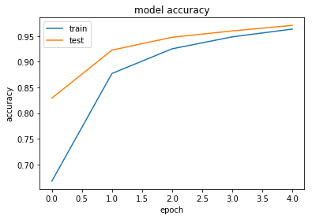
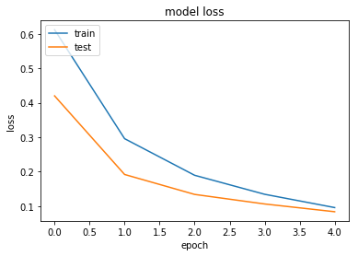
Model Results
The Model is Trained on 16640 samples and tested on 10400 samples of Kaggle Dataset

Slide 13
Experimental Setup For Deep CNN Model
Dataset is same as used for CNN Model i.e., Kaggle Dataset
We use 80% of the data for training, 10% of the data for validation and 10% of the data for testing
11 convolutional layers are used with different filter sizes
A dropout layer is added to reduce number of trainable parameters
The experiment is run on 2 epochs

Slide 14
Very Deep CNN Model
Input Embedding Layer
Conv1d +
BatchNormalization+Max Pooling+ReLu activation
Conv1d +
BatchNormalization
Conv1d +
BatchNormalization+ReLu activation
Conv1d +
BatchNormalization+ReLu activation
Conv1d +
BatchNormalization+ReLu activation
Conv1d +
BatchNormalization+Max Pooling+ReLu activation
Conv1d +
BatchNormalization+Max Pooling+ReLu activation
Conv1d +
BatchNormalization
+Dropout
(0.1)
Conv1d +
BatchNormalization
Conv1d +
BatchNormalization+ReLu activation
Conv1d +
BatchNormalization+ReLu activation
Dense1+ReLu
(1024)
Dense1+ReLu
(512)
Dense1+ReLu
(128)
Flatten
Dense1+ReLu
(2)

Slide 15
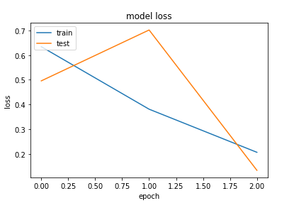
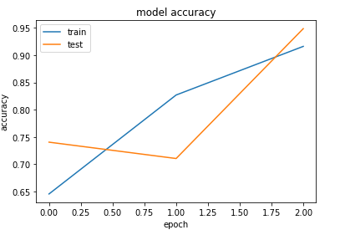
Model Results

Slide 16
Conclusions and Future Work
CNN model can see entire input at once and is much faster than LSTM and other RNN Models
Deep CNN are more reliable than Text Classification Than CNN removing chance of underfitting or Overfitting
Experimental Result Shows that CNN can detect fake news depending on explicit features learned from convolutional neurons
TI- CNN can be used to draw co relation between Text and Image of fake news data

Slide 17
THANK YOU!!!!

